Slide 1


Minimum Time to Finish the Race
This project aims to determine the minimum time required to complete a race given a set of tires with varying performance characteristics. The goal is to develop an efficient algorithm that optimizes tire selection and minimizes the overall race time.

Slide 2

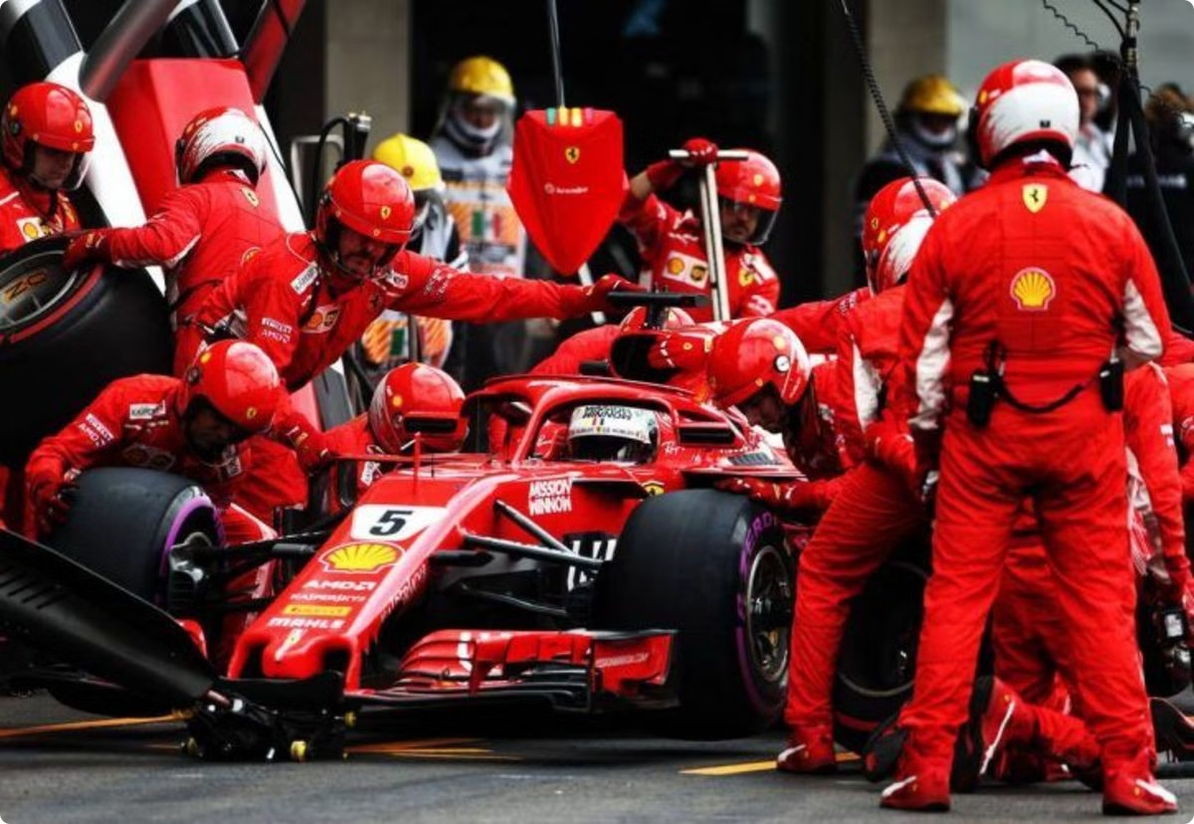
Problem Statement
Input
Output
The input consists of a 2D array representing tire performance, a change time, and the number of laps in the race.
The output is the minimum time required to complete the race.
Constraints
The input array must have a valid format, the change time must be non-negative, and the number of laps must be positive.

Slide 3


Tire Characteristics
Tire
Lap 1
Lap 2
Lap 3
Tire 1 (fi = 3, ri = 2)
3
6
12
Tire 2 (fi = 5, ri = 1)
5
5
5

Slide 4

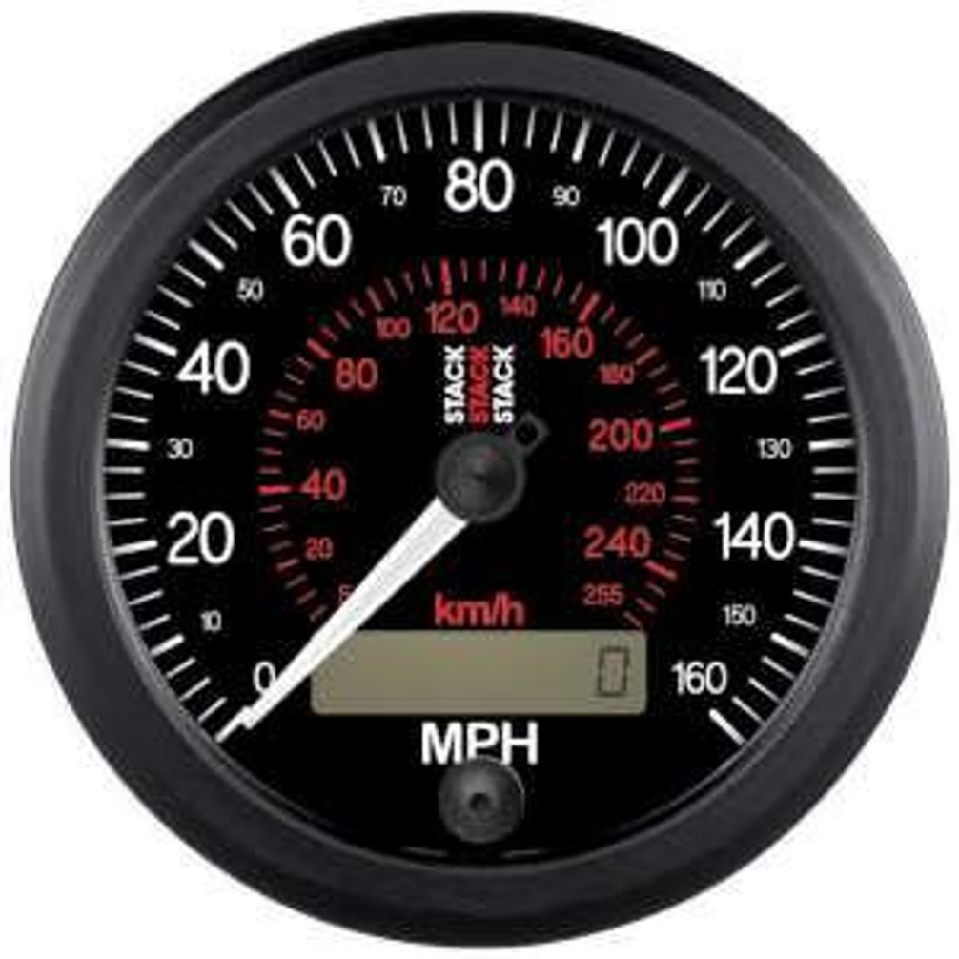



Lap Time Calculation
Lap 1
The time for the first lap is simply the fi value of the chosen tire.
Lap 2 onwards
For subsequent laps, the time is calculated as fi * ri^(x-1), where x is the lap number.
Total Time
The total time for a set of laps is the sum of individual lap times.

Slide 5

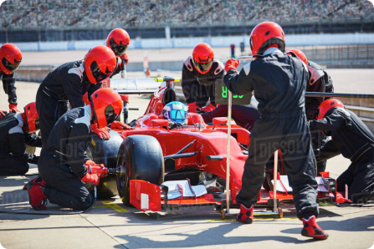
Tire Selection Strategy
1
Minimize Lap Times
2
Consider Tire Degradation
3
Optimal Switching Points
The goal is to select tires that minimize the overall race time, taking into account the change time.
Determining when to switch tires to minimize total race time is a key aspect of the optimization problem.
Tire performance degrades over time, as reflected in the ri value. The choice of tires should account for this degradation.

Slide 6


Minimum Time Calculation
1
Initialization
Start with a base case where all laps are completed using the same tire.
2
Iterative Optimization
Explore various combinations of tires and switching points, calculating the total time for each combination.
3
Dynamic Programming
Employ dynamic programming techniques to store and reuse intermediate results, improving efficiency.
4
Minimum Time Selection
Select the combination of tires and switching points that yields the minimum total race time.

Slide 7
Edge Cases and Considerations
Zero Change Time
Single Tire
Tire Degradation
If the change time is zero, the optimal strategy is to always use the tire with the lowest lap time for each lap.
If there is only one tire available, the minimum time is simply the total time for completing all laps with that tire.
Consider the effect of tire degradation on the overall time and adjust the tire selection strategy accordingly.

Slide 8

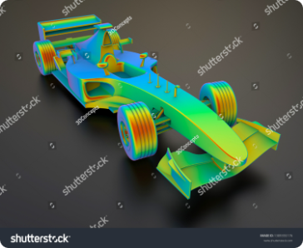



Optimization Techniques
Greedy Approach
Dynamic Programming
Graph Search Algorithms
Select the tire with the minimum lap time for the current lap, ignoring future performance.
Store and reuse intermediate results to avoid redundant calculations, improving efficiency.
Represent the tire selection problem as a graph and use algorithms like Dijkstra's or A* to find the shortest path.

Slide 9

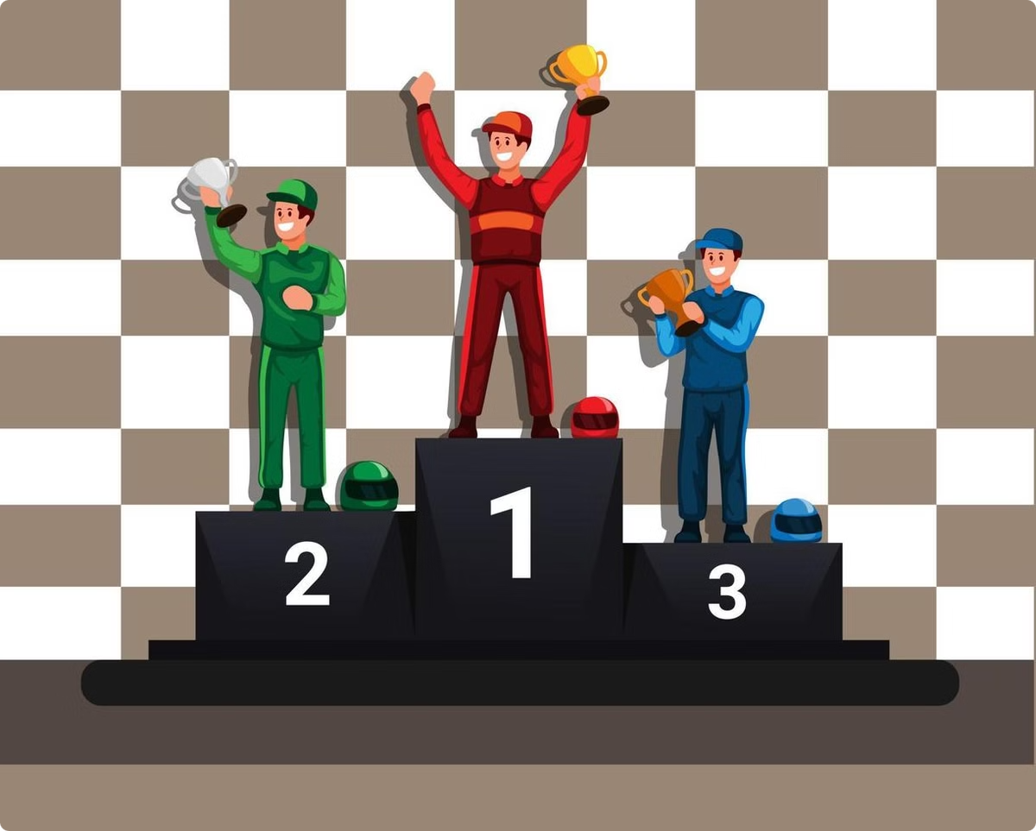
Conclusion
The project successfully developed an efficient algorithm for determining the minimum time to complete a race given tire performance characteristics, change time, and number of laps. This algorithm utilizes a combination of optimization techniques to minimize the total race time, providing valuable insights for race strategy and tire management.

Slide 10
THANK YOU

